Slide 1
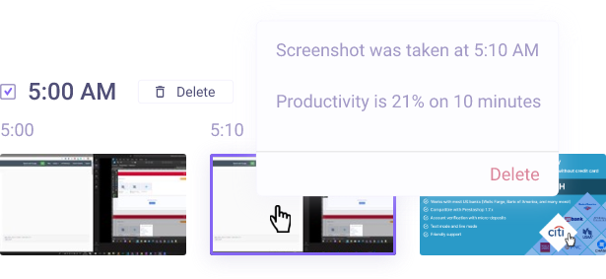
Weekly Ethicacy: Electronic Surveillance in the Workplace
Marieke Thomas and Jessica Novillo Argudo

Slide 2
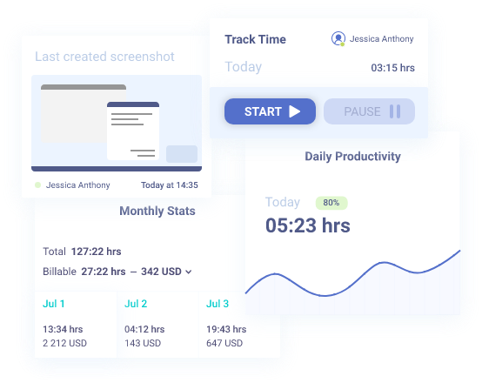
What is electronic surveillance in the workplace?
Notes:
Eight of the 10 largest private U.S. employers track the productivity metrics of individual workers, many in real time". For instance, J.P. Morgan tracks their employees' activities, from making phone calls to composing emails, and UPS and Amazon track their employees at all times. This tracking may include may include taking photographs of workers’ faces and screens and measuring idle time, clicks, and keystrokes, and has been used to determine hours worked for employee compensation.

Slide 3
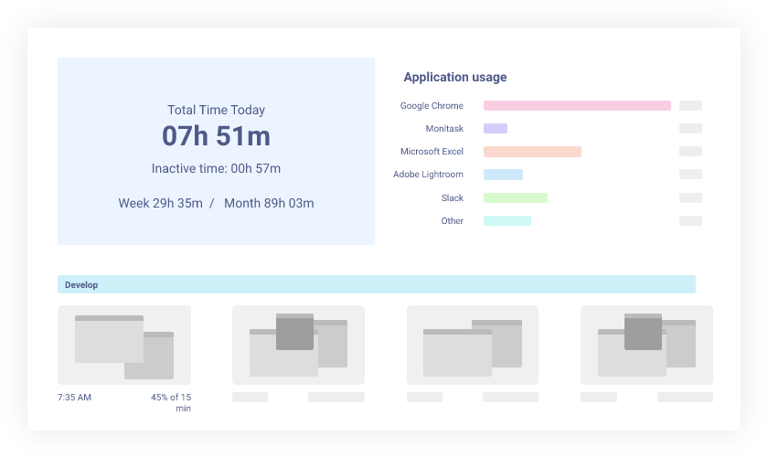

Slide 4

Pros
Saves money
WFH
More objective
Ensures team members contribute their fair share
Solidarity
Can be implemented without logging keystrokes

Slide 5

Cons
Employee's privacy is violated
Keylogger programs track sensitive information
Record private conversations
Collect health data
Employees are paid based on their "active work."
Prolonged "idle time" = penalties (lost pay to lost jobs)
Generates a false idea about employees' work performance
Electronic trackers cannot judge humans’ work
Employees could cheat (mouse jiggler)
Decreases productivity
Employees feel pressure = poor work performance

Slide 6

Employers should trust their employees
We are humans not robots
Pause from work is needed to clear minds and make work more efficient

